Slide 1
Trustpilot Funnel Update
24/05/2022
Presented by: Data Planning @ MG OMD

Slide 2
01
Intro to funnels

Slide 3
Decision Funnel analysis
Decision Funnel Analysis is also known as the purchase funnel, and describes the customer journey from the first moment of contact with your brand to the ultimate goal of a purchase / subscription.
Decision funnel analysis is an important tool which can help with the following
Planning marketing campaigns
Budget setting
Highlighting areas in order to improve your conversion rate (from potential to actual customers)
Evolving the sales process
The analysis usually requires at least 2 years* of data as these metrics tend to shift slowly over a long period of time.

Slide 4
BRAND EQUITY RELATIONSHIPS
The customer decision journey can be seen to follow a linear path, starting with customers becoming aware then all the way through to transaction.
This can be represented through a static funnel, or a dynamic funnel.
Unaware
1. Unaided Awareness
2. Aided Awareness
3. Familiarity
4. Brand/Product understanding
5. Of critical value to their business
6. Interested in the market
Brand Ambassador

Slide 5

STATIC FUNNELS
DYNAMIC FUNNELS
The average score is taken at a static point in time across all metrics selected for the brand funnel. This could be end of year for example, using the average across the year. These can be run for the brand and competitors or the category to compare the funnel levels and shape.
Dynamic funnels quantify how each element in the funnel relates to the next, ultimately joining all the metrics across the funnel from comms spend through to sales, allowing the funnel to react dynamically when the first metric (spend) is changed.
Comms Spend
Awareness (brand & ad)
Research & familiarity
Opinion & short list
Consideration
Purchase intent
Sales
(or similar metric)

Slide 6
02
Proposed Approach

Slide 7


We propose both static and dynamic funnels
By adopting both approaches we will be able to quantify the strength of the Trustpilot brand along with understanding how this can be increased. The output and benefit of both are summarised as:
STATIC FUNNEL ANALYSIS:
The static funnel looks at the decision funnel and diagnoses the levels across brand measures and recommends actions to improve performance. It’s used to:
Understand which parts of the funnel are most important in a category
Identify which levels of the funnel we over or under perform on as a brand
Understand the role of marketing at each part of the funnel- where can we impact?
Understand your competitors strengths and weakness
Understand how to use your marketing budget to influence the right parts of the funnel
Can we looked at, at key points over time to monitor change (e.g. quarterly or half yearly)
DYNAMIC FUNNEL ANALYSIS:
The dynamic funnel takes the analysis a step further to understand how each level of the funnel relates to the next, creating a dynamic relationship. I can help inform:
Which levels are more elastic / sensitive than others to communications spend
How we perform on the conversion relationship between each metric versus the competition
How communication spend can be used to fill and fatten the funnel
What level of investment would be required to achieve different sales targets
Notes:
This is the standard actual vs. fitted chart for a KPI
The actual line should be an orangey red as from the BrandScience colour palette. The fitted line should be pale blue so that the contrast is clear

Slide 8
A 2 parts project
Part one
Part two
Static funnels for Trustpilot
Static funnels for Key competitors
Feasibility leading to Go / No Go decision on dynamic funnels
Dynamic funnels linking all elements of the funnel from media spend through the funnel
Light Scenario planning tool for brand shifts linking to business outcomes

Slide 9

Why do we need 2 parts?
1
This type of analysis usually requires 2 years of monthly or quarterly data, as most key brand metrics such as consideration move slowly
1
2
2
We will only have seen the impact of 1 brand campaign
3
This stage of the process will tell us if we can build dynamic funnels for Trustpilot: are there clear relationships?
3
4
If we can’t go ahead we will only provide you with static funnels, which can still help us identify strengths and weaknesses vs the category/ competition, but not the level of investment required to shift/ meet a target on any brand metrics

Slide 10
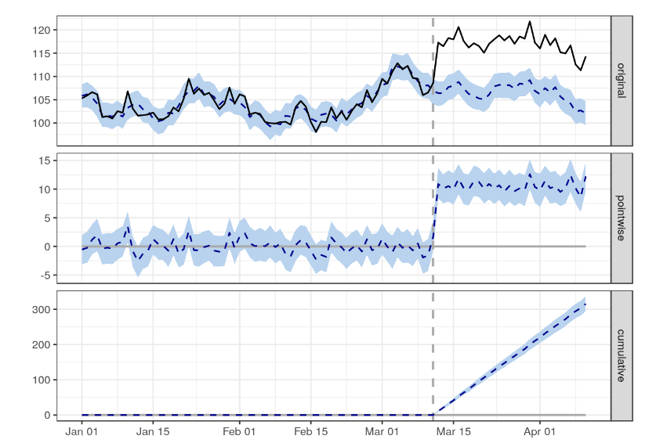
Mid campaign dip: Causal Impact Analysis
Funnel analysis is traditionally used to measure longer term impact of advertising on the customer funnel. We wouldn’t necessarily recommend it as an approach to check for mid-campaign improvements. The main reason is that the metrics we’re trying to shift don’t do so very quickly
CIA is an approach developed by Google to estimate the effect a campaign has on a set of KPIs such as: web-visits; searches of key words; etc.
It can only answer the question: has the campaign had an impact? It cannot look into disentangle the effect of different media channels

Slide 11
03
Example Outputs

Slide 12
Example of static funnels: compare vs. market or specific brands
Market
Client X
Taking the static view we will be able to benchmark Trustpilot’s profile for a given product group versus the market
A comparison of Trustpilot versus the market would be done at any audience required e.g. B2B and/or B2C
N.B the metrics shown here are example metrics- we would select the relevant ones from the Trustpilot Tracker/Yougov, so they are specific to the brand and category

Slide 13
Example of static funnels: can we measure an impact mid-burst?
Campaign Start
Mid-campaign
Post campaign
✓(↑)
✗
✓(↑)
✓(↑)
✓(↑)
✓(↑)
✗
✓(↑)
✓(↑)
✗
✓(↑)
✓(↑)
✓(↑)
✗
✗
✓(↑)

Slide 14
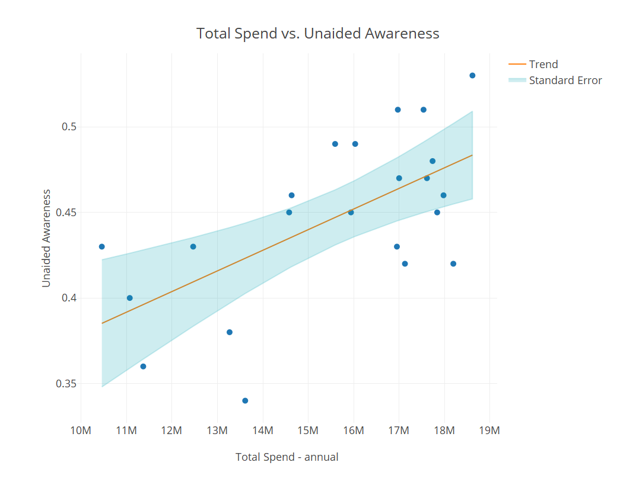
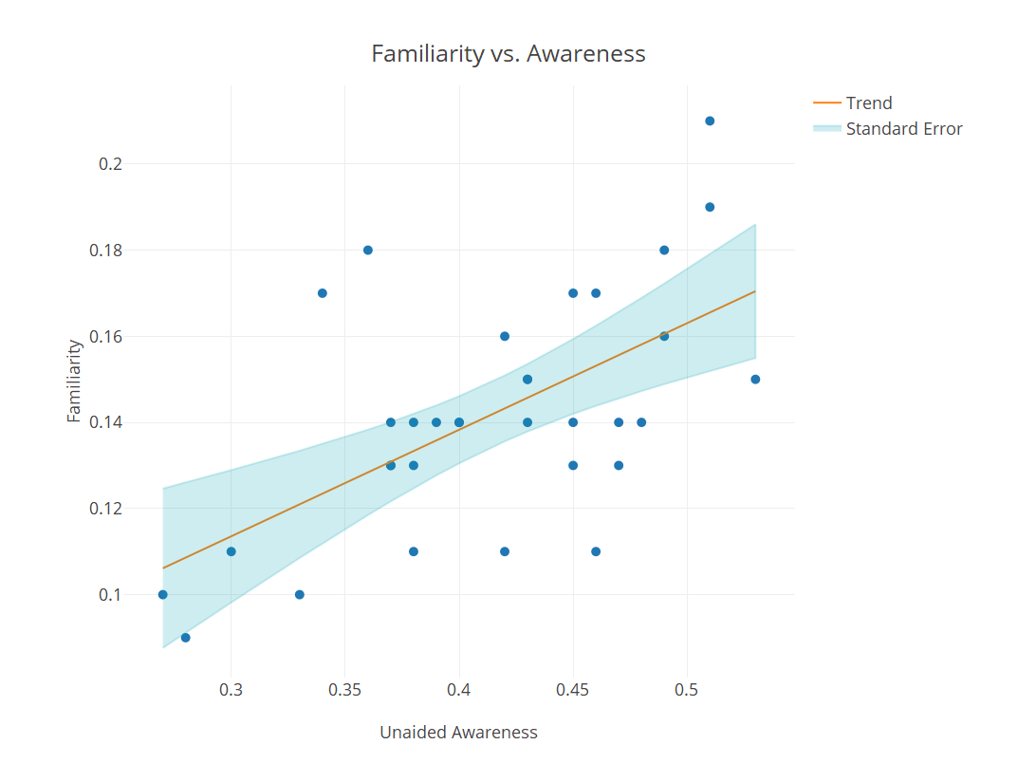
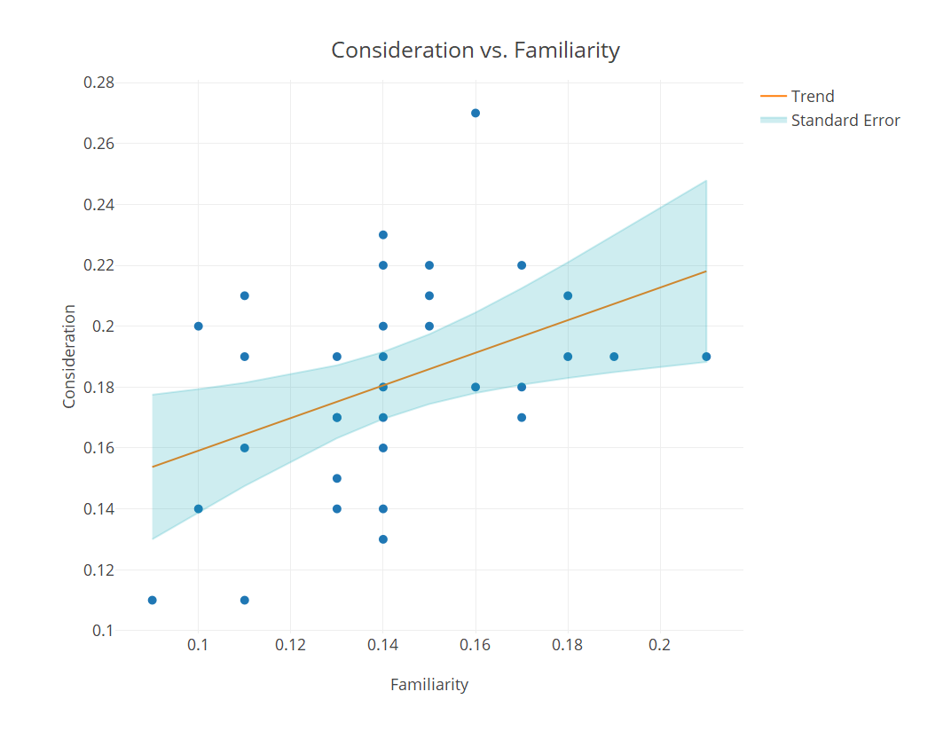
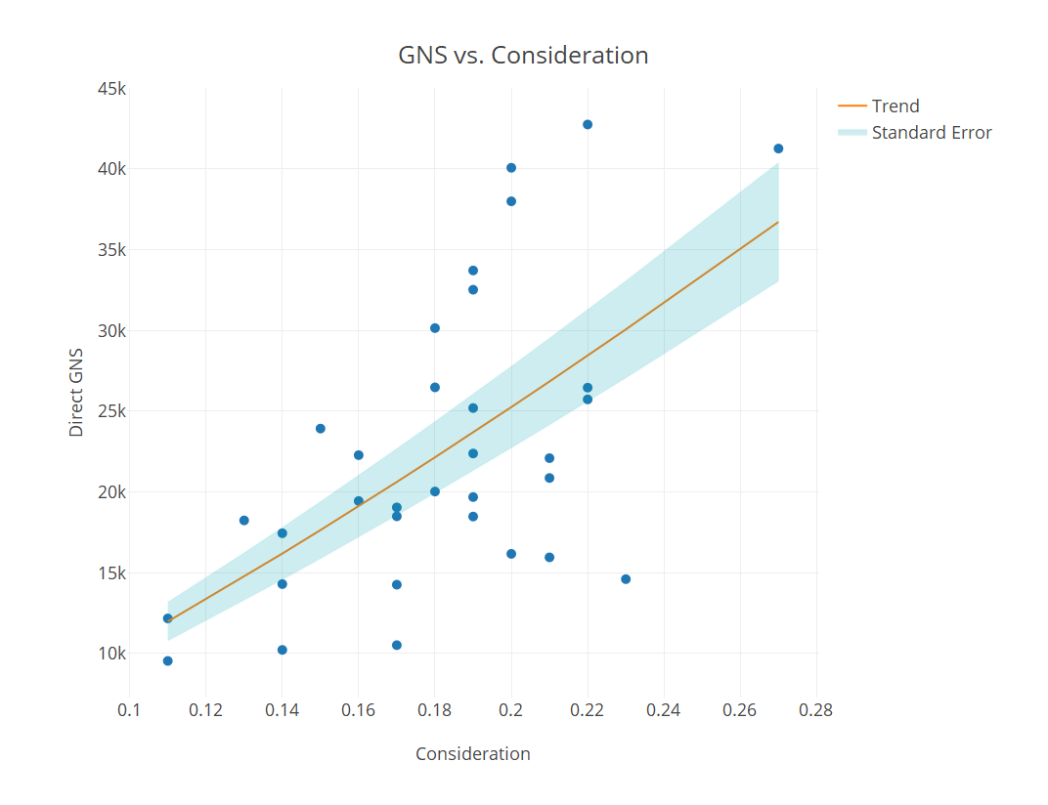
How dynamic funnels work
1
2
Instead of simply looking at the relationship between different layers of the funnel at a given point in time, we are looking to prove a causal relationship between them over time
We create simple regression models and can then use the results of the models to create a scenario planner or design scenarios for you
If two layers don’t influence one another we will exclude the meaningless one(s) from the analysis
3
4
Reviews vs. Consideration
Reviews

Slide 15
04
Timelines and cost

Slide 16
Cost
 | UK | Italy
Part 1 | £4,000 + VAT | £4,000 + VAT
Part 2 | £10,000 + VAT | £10,000 + VAT
Mid-campaign dip (C.I.A.) | £6,000 + VAT | £6,000 + VAT
Total for each market | £20,000 + VAT | £20,000 + VAT
2 markets total |  | £40,000 + VAT

Slide 17

Timings a for full project
Week 3
Dynamic Funnels
Week 4
Implications & Debrief
Week 5
Dynamic Funnel scenario tool
Week 2
Static Funnels & Feasibility of Dynamic funnels
Week 1
Data collection – as soon as media is consolidated/tracking available
NOTE: Timelines reflect a full scope project (Parts 1 +2). CIA results can be delivered in c. 2 weeks from receipt of data

